Slide 1



CROWDSTRIKE
AN INDUSTRIAL CASE STUDY

Slide 2

DATA 225 GROUP-6
Harsimran K. | Karnik K. | Mounica A. | Saumya S. | Vidushi B.
(016003468) | (016038282) | (015969759) | (016040674) | (015309736)

Slide 3
CROWDSTRIKE - INTRODUCTION
It’s a Cyber Security technology company specializes in
endpoint security,
threat intelligence and
cyber attack responses
Falcon product of CrowdStrike,
fully Software-as-a-Servive (SaaS) based endpoint(URL) protection solution.
Cloud-based technology
Requires no on-prem hardware
Rapid Deployments

Slide 4
DATABASE IN ACTION
CrowdStrike use database technologies primarily
for storage, management, access and analysis of their cyber security product offerings.
for storage, management, access and analysis of their in-house departmental data that helps run the organization.

Slide 5
PRODUCT - FALCON
Falcon uses Threat Graph that is the brain behind it.
THREAT GRAPH : is a graph database that is used for behavioral analytics, machine learning and artificial intelligence, proactive threat hunting to provide security against unprecedented threats.
THREAT GRAPH: captures correlations of trillions of security events per day.
Raw data is meaningless, threat graph is an ideal representation to capture relationships between data points, as well as external sources such as threat intelligence.

Slide 6
Till date CrowdStrike has collected, analyzed and stored more than 15 petabytes of data, generated through hundreds of billions of security events coming from millions of endpoints across the globe and indexes them for quick access.
It currently manages around 2 trillion vertices.
It has been instrumental in finding security breaches in some high profile cases as it helps with cyber security intelligence for US government.

Slide 7
MOTIVATION TO BUILT THREAT GRAPH
Enormous volume of data.
No defined predictable patterns, unpredictable write rates
System needed to anticipate and absorb unexpected burst of traffic in a very short time.
Need to work with tremendous speed, flexibility and agility

Slide 8
DESIGN OF THREAT GRAPH DB
Extreme trade-off between complexity and scale.
System should manage hundreds of billions of events per day.
To build a strong and versatile platform, a simple schema design is needed that can scale endlessly.
Represent GRAPH using ADJACENCY LIST

Slide 9
THREAT GRAPH DESIGN
THREAT GRAPH works on “append only” mode.
No records are updated. Only appended.
Reduced database overall latency and Increased throughput.
Minimize read cost using necessary “dials” providing edge to collection and storage in write intensive database.

Slide 10
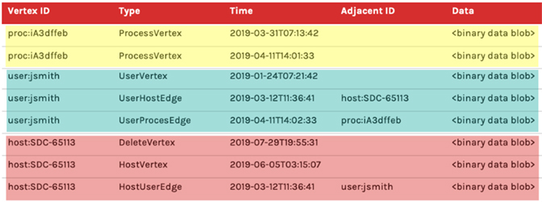
THREAT GRAPH ADJACENCY LIST A SINGLE TABLE TO REPRESENT BOTH VERTICES AND EDGES

Slide 11
THREAT GRAPH DESIGN
Retrieve all data by executing exactly one query in exactly one table.
Column (Type) allows to distinguish what each row of data represents.
The query should be able to do a sequential read as the data is indexed to be contiguously based on the common vertex ID.
This Vertex ID is shared with vertex details and edges.

Slide 12
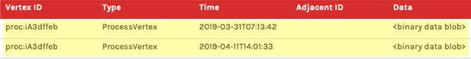
Yellow rows highlight the “append-only” nature of this data model.
Program handles the collisions when two rows of the same vertex types want to change the same property.

Slide 13
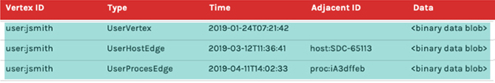
Cyan rows represent all of the data for a vertex stored including its details and edge relationships to read efficiently.
Vertex has its detail data in column DATA
Edges have their own properties that are present in column DATA.

Slide 14
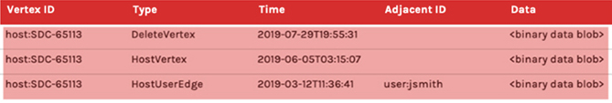
Red rows demonstrate the nodes that are “deleted”.
Also see that for delete, a new row is created in “append only” model.
If any vertex is deleted, it will be the first record marked as a deleted vertex.
Because delete records have a lower sort value than other records that are sorted on index.
Therefore, process skips and stops reading any additional rows since this vertex is now considered deleted.

Slide 15
KEY LEARNING FROM THREAT GRAPH
The reasons why CrowdStrike has such a stellar scalability record
because of the simplicity of the design of threat graph
the architecture is able to adapt to the needs of the market.
Graph databases can be very helpful in security domain
Capturing the essence of the relationships between the entities make graph databases very efficient.

Slide 16


IN-HOUSE DATA ANALYTICS
CrowdStrike uses Data warehouses and Data Lakes for the Analytical Purposes.
Apart from getting insights about cyber security, Crowdstrike utilizes Data warehousing along with machine learning and AI to gain insights about their different in-house departments.

Slide 17
BACKEND PROCESS
Backend financial team uses Cloud based data warehouse - Snowflake and cloud based ETL tool – Matillion
They have ER diagrams that helps the team in understanding all the entities and objects and their relationship with each other so that the data is pulled correctly to the desired destination.
Main source of the data is Salesforce so ER diagrams of all its objects and relationships are documented.
Understanding of the logical schema becomes easy for the newly hired employee.

Slide 18
DATA PIPELINES
Backend financial team does not have any pre-defined project pipeline.
Depending on requirements and the end goals, pipelines are built.
Every data has different need.
Sometimes framework is established with combination of logics, snowflake data warehouse tool, Matillion, python scripting etc.

Slide 19

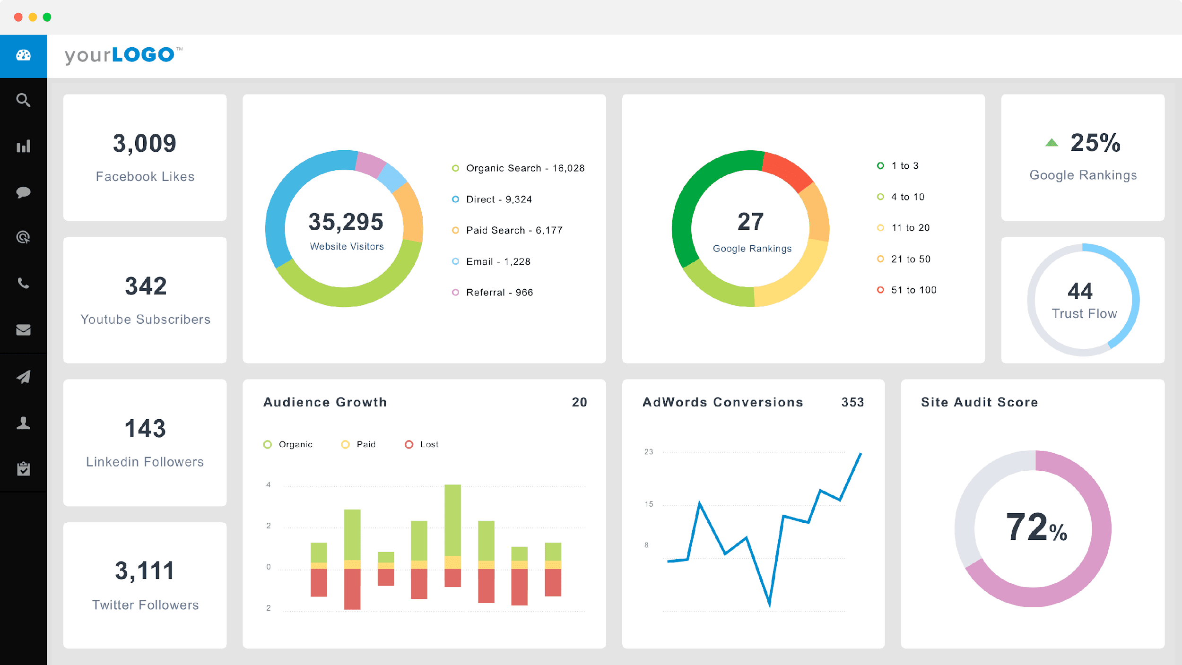
DATA PIPELINE – EXTRACT LOAD TRANSFORM
R
E
P
O
R
T
G
E
N
E
R
A
T
I
O
N
FILES
O
D
S
L
A
Y
E
R
D
A
T
A
M
A
R
T
S
FINANCE
DM
FINANCE
SALES
SALES
SFDC
DM
SFDC
NETSUITE
NETSUITE
NORMALIZED
SCHEMA PRODUCTION SYSTEMS
LOAD THE TABLES AS IS
TRANSFORM THE DATA LOADED
REPORTS AND DASHBOARDS

Slide 20
CROWDSTRIKE USES ELT INSTEAD OF ETL
ETL
Hard to automate
Costly to change the transformations
ELT
Extract and load can be automated
Changing transformations can be simply done by changing SQL queries and re-running them against the normalized tables.

Slide 21
ELT – EXTRACT AND LOAD
Crowdstrike uses snowflake Data warehouse.
DATA is pulled from disparate sources such as NETSUITE, SFDC, files
The data is loaded as is in the separate databases related to each data source.
The new databases are also in normalized forms.

Slide 22
DATA TRANSFORMATION
Data is fetched from the loaded database and transformation logic is applied to it.
Scripts and SQL is used for transformation logic.
The logic converts normalized tables into fact tables and dimension tables.
Fact tables consists of the aggregates that are measurements required to gain insights along with the foreign keys of dimension tables.
Dimension tables consists of contextual data that are related to the facts.

Slide 23
DATA TRANSFORMATION - CONTINUED
Transformation is applied and fact and dimension tables are stored in each departmentalized data mart.
DATA MARTS present in snowflake send their data to Data Lakes for further analytical purposes.
Matillion is also used for the purpose of ELT.

Slide 24
REPORT GENERATION
Reports and Dashboards are generated using Tableau and DOMO.
DATA Analysts and engineers designs different set of views that are utilized by visualization tools for report generation.
These reports may give valuable insights to the higher management about the questions that they asked.

Slide 25
….IN A NUT SHELL
Data is pulled by establishing connection with the disparate data sources.
Data is mostly in structured form for which they use SQL widely across their project.
The data may also come in unstructured forms like JSON files.
It is then understood, analyzed, cleaned.
Transformation logic is applied on it to give it a structural meaning
Sometimes data is dissected into dimensions and fact tables. Different logic is applied to compute certain requirements.
Finally, this data is used by a data visualization tool -DOMO to create reports , dashboards that are eventually presented to the stakeholders.

Slide 26
KEY LEARNINGS
Mostly standard procedure is followed across the industry.
Knowing concepts is important.
Learning one tool of each type will help with learning the new ones easily as tools are similar.
Getting familiarized with cloud based interface is very important as the industry is running on cloud.
Our course topics are very relevant with the industry processes and standards.

Slide 27
References
• Threat Graph | Falcon Platform | CrowdStrike. crowdstrike.com. (2022). Retrieved 25 April 2022, from https://www.crowdstrike.com/falcon-platform/threat-graph/.
Threat Graph | Data Sheet | CrowdStrike. crowdstrike.com. (2022). Retrieved 25 April 2022, from https://www.crowdstrike.com/resources/data-sheets/threat-graph/.
• Crowdstrike.com. (2022). Retrieved 25 April 2022, from https://www.crowdstrike.com/wpcontent/uploads/2020/03/threat-graph.pdf

